Slide 1
Competitive Programming
The 3rd Session
19 Aug. 2022
Andrei Novikov

Slide 2
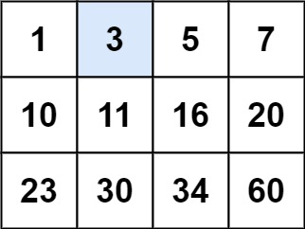
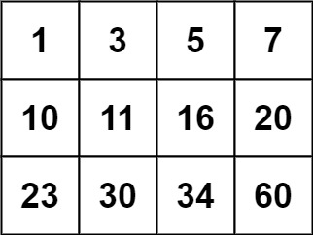
Challenge #1
Write an efficient algorithm that searches for a value target in an m x n integer matrix matrix. This matrix has the following properties:
Integers in each row are sorted from left to right.
The first integer of each row is greater than the last integer of the previous row.
Example 1:
Input: matrix = [[1,3,5,7],[10,11,16,20],[23,30,34,60]], target = 3
Output: true
Example 2:
Input: matrix = [[1,3,5,7],[10,11,16,20],[23,30,34,60]], target = 13
Output: false

Slide 3

Challenge #1 – Time to Think
Time to Think (5 minutes)

Slide 4
Challenge #1 - Think
Write an efficient algorithm that searches for a value target in an m x n integer matrix matrix. This matrix has the following properties:
Integers in each row are sorted from left to right.
The first integer of each row is greater than the last integer of the previous row.
Example 1:
Input: matrix = [[1,3,5,7],[10,11,16,20],[23,30,34,60]], target = 3
Output: true
Example 2:
Input: matrix = [[1,3,5,7],[10,11,16,20],[23,30,34,60]], target = 13
Output: false

Slide 5
Challenge #1 – Implementation
The following syntax is proposed to solve the problem:
class Solution {
public:
bool searchMatrix(vector<vector<int>>& matrix, int target) {
}
};
Share Screen and Solve the Problem

Slide 6

Warm-Up – Challenge #1 - Submit
Problem origin: LeetCode
Complexity: Medium
Link to Submission: https://leetcode.com/problems/search-a-2d-matrix/submissions/

Slide 7
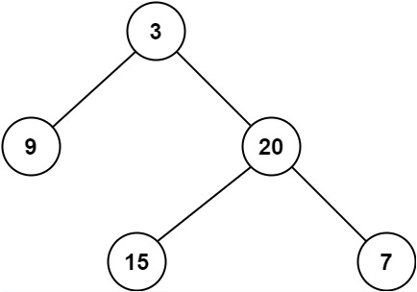
Challenge #2
Given a binary tree, find its minimum depth.
The minimum depth is the number of nodes along the shortest path from the root node down to the nearest leaf node.
Note: A leaf is a node with no children.
Example 1:
Input: root = [3,9,20,null,null,15,7]
Output: 2
Example 2:
Input: root = [2,null,3,null,4,null,5,null,6]
Output: 5

Slide 8
Challenge #2 – Time to Think
Time to Think (5 minutes)

Slide 9
Challenge #2 – Think
Given a binary tree, find its minimum depth.
The minimum depth is the number of nodes along the shortest path from the root node down to the nearest leaf node.
Note: A leaf is a node with no children.
Example 1:
Input: root = [3,9,20,null,null,15,7]
Output: 2
Example 2:
Input: root = [2,null,3,null,4,null,5,null,6]
Output: 5

Slide 10
Challenge #2 – Implementation
The following syntax is proposed to solve the problem:
/**
* Definition for a binary tree node.
* struct TreeNode {
* int val;
* TreeNode *left;
* TreeNode *right;
* TreeNode() : val(0), left(nullptr), right(nullptr) {}
* TreeNode(int x) : val(x), left(nullptr), right(nullptr) {}
* TreeNode(int x, TreeNode *left, TreeNode *right) : val(x), left(left), right(right) {}
* };
*/
class Solution {
public:
int minDepth(TreeNode* root) {
}
};
Share Screen and Solve the Problem

Slide 11
Warm-Up – Challenge #2 - Submit
Problem origin: LeetCode
Complexity: Easy
Link to Submission: https://leetcode.com/problems/minimum-depth-of-binary-tree/submissions/

Slide 12




Where to Practice
LeetCode [link]
HackerRank [link]
Kattis [link]
TopCoder [link]
Other Resources

